Slide 1
Topic: Measurement EQ: Why is estimating and measuring accurately important?
Year 11 Essentials

Slide 2
Things Required For This Lesson
Interactive Notebook
Textbook: Interleaved Maths Essential Connections
Ruler, Red Pen, Pencil, Pens, Scientific Calculator
Growth mindset

Slide 3

24
7
30
Topic: Measurement
EQ: Why is estimating and measuring accurately important?
WICOR
This Photo by Unknown Author is licensed under CC BY-SA

Slide 4
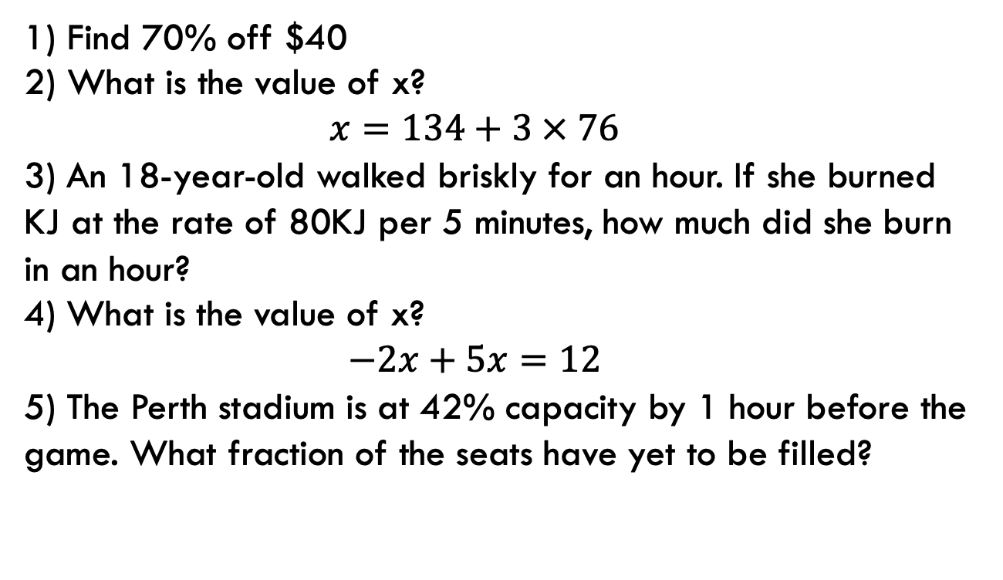
First 5
Answers
1) $12
2) 362
3) 960KJ
4) 4
5) 58/100
29/50
Find 70% off $40
What is the value of x?
$$x=134+3 × 76$$
3) An 18-year-old walked briskly for an hour. If she burned KJ at the rate of 80KJ per 5 minutes, how much did she burn in an hour?
4) What is the value of x?
$$−2x+5x=12$$
5) The Perth stadium is at 42% capacity by 1 hour before the game. What fraction of the seats have yet to be filled?

Slide 5
24
7
30
Topic: Measurement
EQ: Why is estimating and measuring accurately important?
Estimating and measuring length accurately are particularly important in building trades.
When building houses, measurements are usually stated in mm and measurements are used using laser measuring tool to ensure accurately.
Inaccuracies can arise when measuring tools are not used appropriately, which makes estimation skills especially important for spotting problems.
WICOR

Slide 6
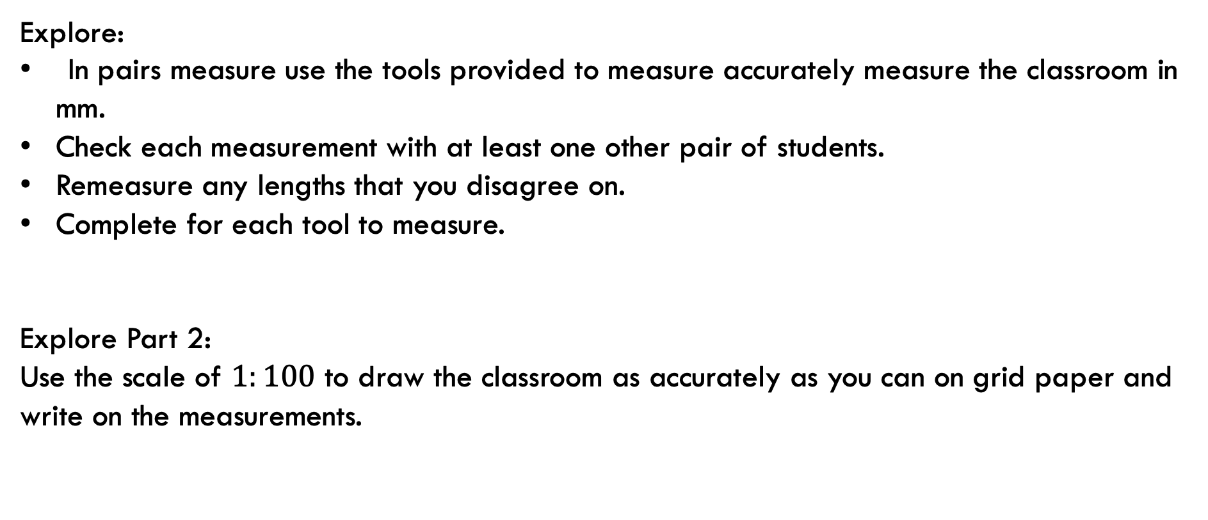
24
7
30
Topic: Measurement
EQ: Why is estimating and measuring accurately important?
Explore:
In pairs measure use the tools provided to measure accurately measure the classroom in mm.
Check each measurement with at least one other pair of students.
Remeasure any lengths that you disagree on.
Complete for each tool to measure.
Explore Part 2:
Use the scale of $1:100$ to draw the classroom as accurately as you can on grid paper and write on the measurements.
WICOR

Slide 7
24
7
30
Topic: Measurement
EQ: Why is estimating and measuring accurately important?
In small groups - Discuss some pitfalls in measurement.
Examples:
Not pointing the laser tool squarely or at right angles (90º). This makes the measurement longer than it should be.
An object getting in the way of the beam, therefore measuring the wrong distance. This makes the measurement shorter than it should be.
Not measuring from start to the end. (e.g. measuring the wall length along the floor but starting from the edging rather than from the wall itself).
WICOR

Slide 8

Thank you
Keep up the good work!
Quote of the day – “If you stumble, make it part of the dance.”

